Slide 1

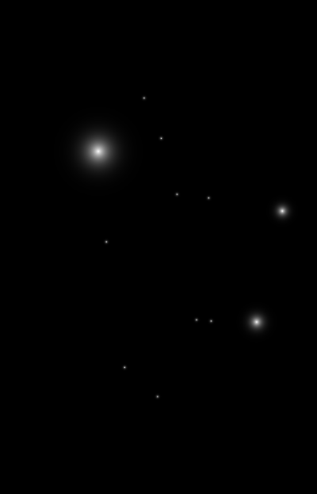

SMS SPAM Detection using Machine learning
Supervised by
Dr/ Diaa Salama AbdElminaam
&
Eng/ Tarek Talaat
By Ahmed AbdelRahman
Ahmed Ayman
Ahmed Mohammed Adel
Ahmed Mohammed AbdelSadek
Bassel AbdelRahim

Slide 2

TABLE OF CONTENTS
01
02
03
Introduction
Related Works
Methodology
04
05
Results & Analysis
Conclusion

Slide 3
Introduction
01

Slide 4


Introduction
SMS spam detection is crucial in modern communication, addressing the rising challenge of unsolicited messages.
Privacy and security concerns underscore the need for robust detection methods.
Global Impact of SMS Spam:
Widespread use of SMS necessitates effective spam detection.
Decreasing costs of spamming have led to a surge in SMS spam.
Regional variations highlight the global nature of the problem.

Slide 5
Related Works
02

Slide 6
Related Works
We are not the first to people to do research on this problem. Many people, scientist works on this topic to find the best solution to overcome this problem.

Slide 7
Methodology
03
l
Data description
Used Algorithms

Slide 8
1) Dataset description
Methodology
Each dataset consists of 1 feature which is text where the messages saved and has 1 label which is spam or ham, they just differ in text content and number of records.
The first dataset named SMS Spam Detection Applicationit has 5,572 records.
The second dataset named Spam SMS Classification and it has 4,457 records.
The third dataset named Filtering mobile phone spam and it has 5,559 records
NOTE: All the dataset was split into two partitions: 80% for training, and 20% for testing.

Slide 9
Used Algorithms
Methodology
(1)
(2)
(3)
Support Vector Machine(SVM)
Naïve Bayes
K-Nearest Neighbors (KNN)
(4)
(5)
Decision Tree (DT)
Logistic Regression (RL)

Slide 10
Results and Analysis
04

Slide 11
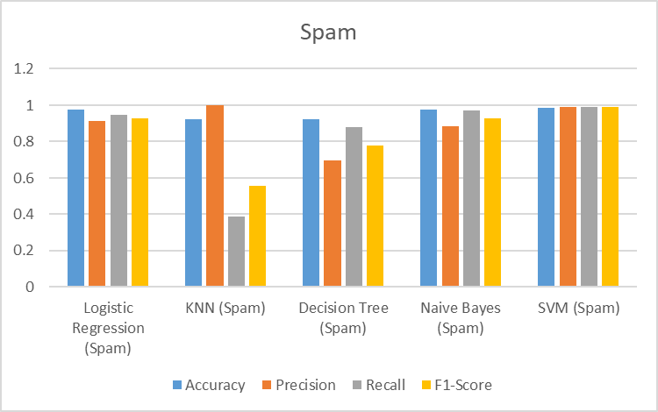
1st Dataset

Slide 12
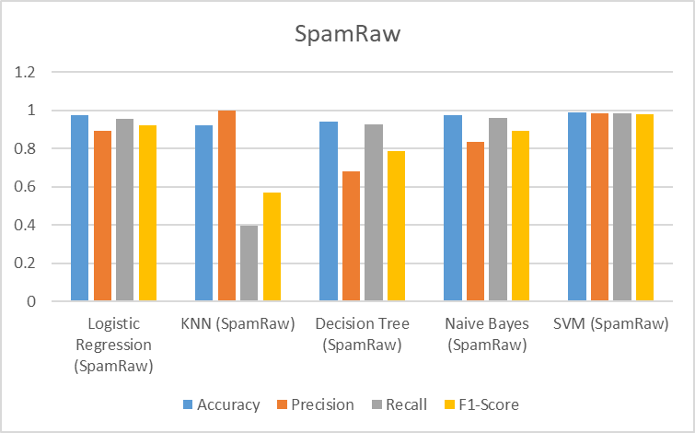
2nd Dataset

Slide 13
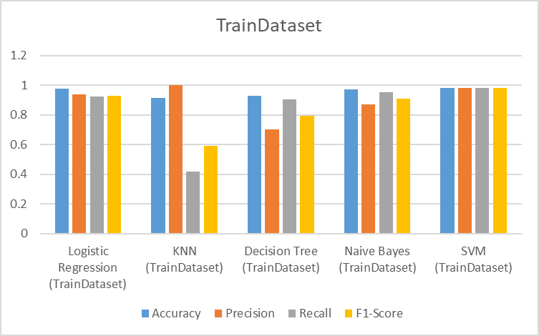
3rd Dataset

Slide 14
Conclusion
05

Slide 15
+ Machine learning is a highly effective and robust approach for detecting SMS spam messages, addressing the challenge of unwanted texts. = Algorithm Performance: Various algorithms and features enhance classification accuracy. Support Vector Machines (SVM) outperformed, achieving an average accuracy of 98.57%, making it the best algorithm for SMS spam detection. = Versatility of Machine Learning: Beyond spam detection, machine learning is applicable in diverse fields. Predictive capabilities extend to stock prices, sports match outcomes, and problem-solving. = Continuous Improvement: Machine learning is a valuable tool for humanity, providing solutions and insights. Ongoing advancements ensure continual improvement and better results over time.
Conclusion

Slide 16
Thank You!

